Slide 1


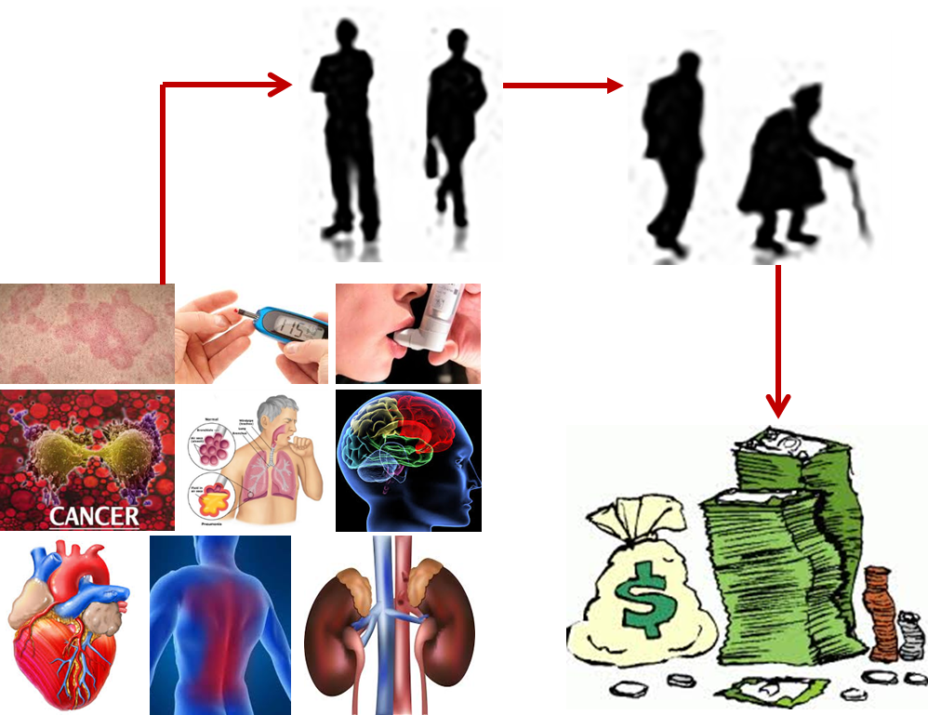
Chronic Condition Predictors of Emergency Room Expenditures Among Uninsured Americans Aged 45-64
Julie Summey, Lu Shi, PhD
Department of Public Health Sciences, Clemson University
Background and Significance
Results
When strategizing how the U.S. can control Medicare costs in the future, policymakers and researchers focus their attention on middle-aged adults and specifically on the uninsured population.¹ As the literature well documents, lacking health insurance is a major barrier for access to care, and as a result, the uninsured are more likely to have unmet medical needs. ¹ ² Since chronic health conditions among the uninsured aged 45-64 are likely to create high costs for Medicare when these individuals turn 65, employers and state governments are working to create plans to cover the uninsured in hopes of reducing future costs.³ ⁴ Efficient prevention and management campaigns need to be data-driven and targeted toward the chronic conditions among uninsured, middle-aged Americans that are associated with significant increases in expenses.
Table 1 provides the results of the Tobit regression. Back problems (β=3845.487, p =.000), cardiovascular disease (β=2544.039, p =.002), kidney disease (β= 4410.912, p = .026), and diabetes (β=2222.17, p =.037) were found to be significant contributors to ER expenditure. There were not enough uninsured cancer patients aged 45-64 visiting an ER to generate results.
Conclusion
ER expenditure signals an inefficient use of health care resources, and ER expenditures beyond age 45 among the uninsured could predict high costs for Medicare. Public health stakeholders in the United States should focus on controlling back problems, cardiovascular disease, kidney disease, and diabetes among the uninsured as these conditions are significant predictors of ER use among the uninsured aged 45-64. In the future, we plan build a two-part model for ER expenditures using cardiovascular disease as our predictor variable.
Purpose
Figure 1: ER Expenditures
Figure 2: Non-Zero ER Expenditures
Purpose: To explore which chronic conditions are associated with emergency room expenditures among uninsured people aged 45-64 living in the U.S.
This knowledge will be used for the purpose of prioritizing coverage of preventive and treatment services.
Methods
References
Data Source: 2012 Medical Expenditure Panel Survey
Sample:
U.S. civilian, non-institutionalized population; N=1102
Independent Variables:
Asthma, back problems, cancer, cardiovascular
disease (CVD), diabetes, kidney disease, mental
disorders, pneumonia, skin problems
Dependent Variable:
Total annual emergency room expenditure
Confounding Variables:
BMI, gender, education level, geographic region,
household income, marital status, race/ethnicity,
smoking
Analytical Method: Tobit regression
¹Gresenz, C. R., Rogowski, J., & Escarce, J. J. (2007). Health Care Markets, the Safety Net, and Utilization of Care among the Uninsured. Health Services Research, 42(1 Pt 1), 239–264. doi:10.1111/j.1475-6773.2006.00602.x
²Pagán, J. A., & Pauly, M. V. (2006). Community-Level Uninsurance and the Unmet Medical Needs of Insured and Uninsured Adults. Health Services Research, 41(3 Pt 1), 788–803. doi:10.1111/j.1475-6773.2006.00506.x
³The High Concentration of U.S. Health Care Expenditures: Research in Action, Issue 19. June 2006. Agency for Healthcare Research and Quality, Rockville, MD. http://archive.ahrq.gov/research/findings/factsheets/costs/expriach/ index.html
⁴Baker, D. W., Sudano, J. J., Albert, J. M., Borawski, E. A., & Dor, A. (2001). Lack of health insurance and decline in overall health in late middle age. N Engl J Med, 345(15), 1106-1112. doi:10.1056/NEJMsa002887
Table 1 Tobit Regression Model for ER Expenditures for the Uninsured, Age 45-64
Chronic Condition | Coefficient | Standard Error | t | P > |t| | [95% Confidence Interval]
Asthma | 1145.51 | 1016.62 | 1.13 | .260 | -849.01 | 3140.03
Back Problems | 3845.49 | 1085.67 | 3.54 | .000 | 1715.50 | 5975.47
Cardiovascular Dis | 2544.04 | 834.69 | 3.05 | .002 | 906.46 | 4181.62
Diabetes | 2222.17 | 1064.88 | 2.09 | .037 | 132.97 | 4311.37
Kidney Disease | 4410.91 | 1985.45 | 2.22 | .026 | 515.63 | 8306.19
Mental Disorders | 1536.26 | 953.26 | 1.61 | .107 | -333.95 | 3406.46
Pneumonia | 5288.27 | 3933.69 | 1.34 | .179 | -2429.29 | 13005.82
Skin Problems | 496.21 | 1681.55 | 0.30 | .768 | -2802.85 | 3795.27

